Slide 1
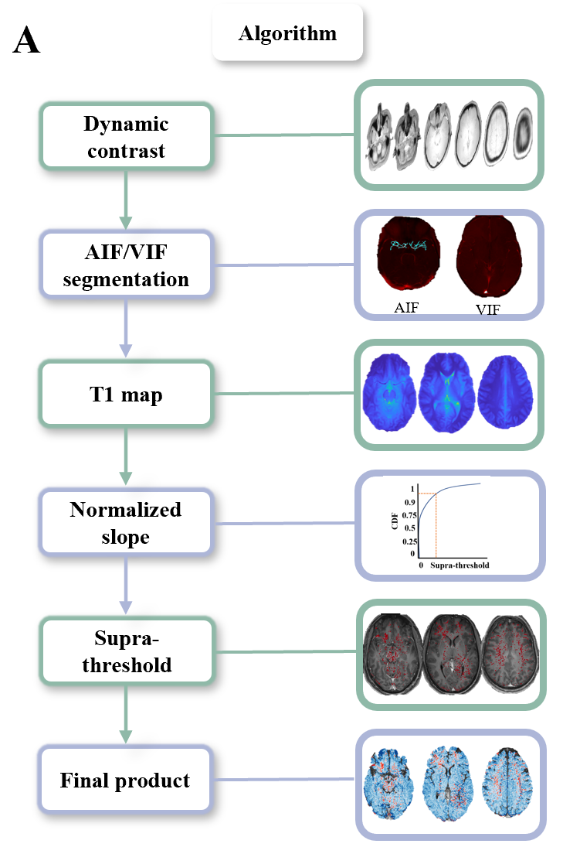
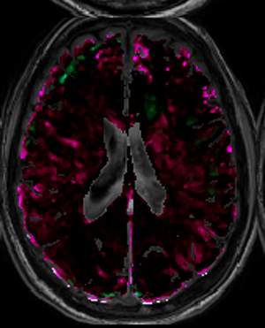
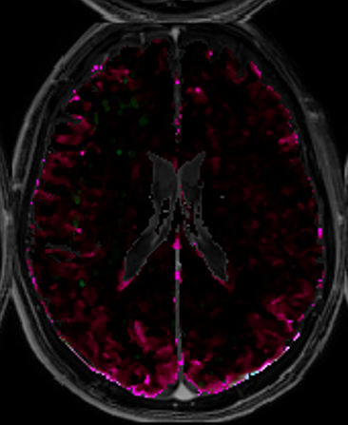
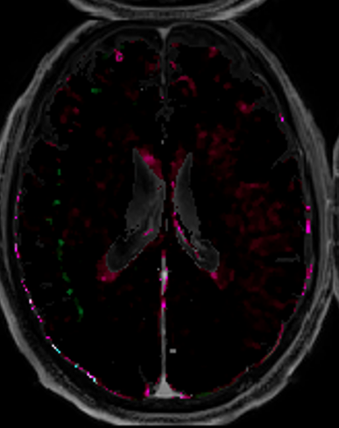
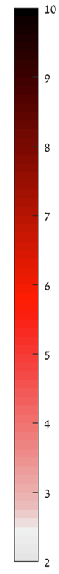

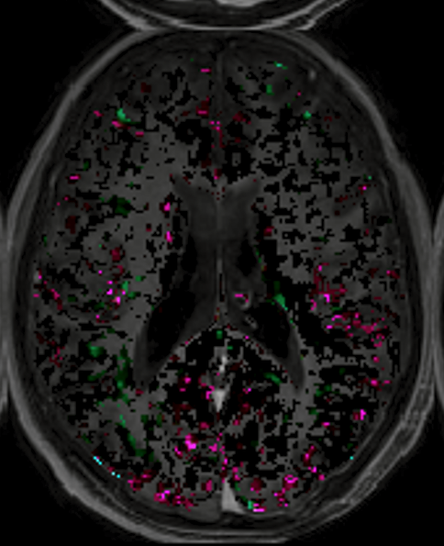
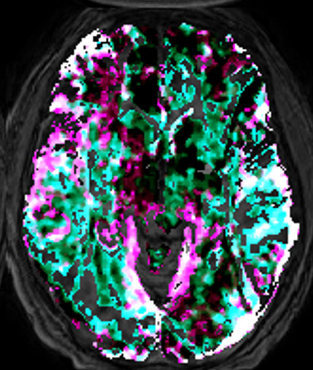
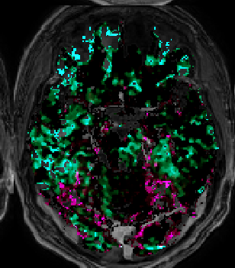
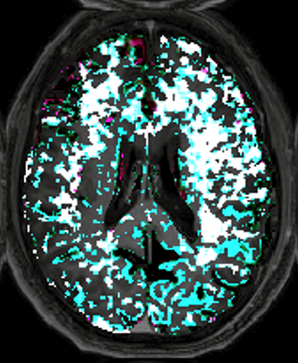
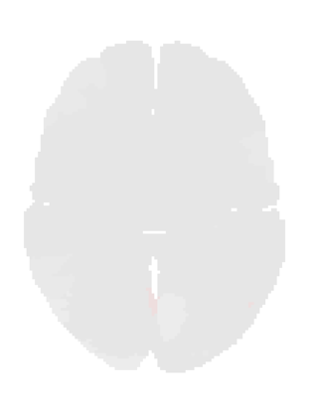











FIGURE 1: Epilepsy vs controls
A Method
B
C Controls
F Epilepsy
1 2 3
1 2 3 4
0 slow 0.1
1 2 3
0 fast 0.1
1 2 3 4
D
G
Fast
STD above controls
Fast
E
1 2 3 4
1 2 3
H
Slow
Slow
Figure 1 DCE-MRI reveals persistent BBBD in epileptic patients. . (A) BBBD analysis method. (B) Epileptic patients’ BBBD% and percent of areas above 2SD from the top 5% of controls statistics compared to controls. (C) Examples of controls without BBBD, with fast BBBD and slow BBBD. (D) Examples of controls fast regional maps. (E) Examples of controls slow regional maps. (F) Examples of patients with epilepsy without BBBD, with fast BBBD and slow BBBD and both fast and slow BBBD. (G) Examples of patients with epilepsy fast regional maps. (H) Examples of patients with epilepsy slow regional maps.
Notes:
3-HY 9719

Slide 2
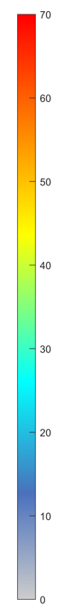
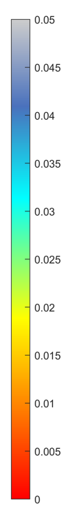
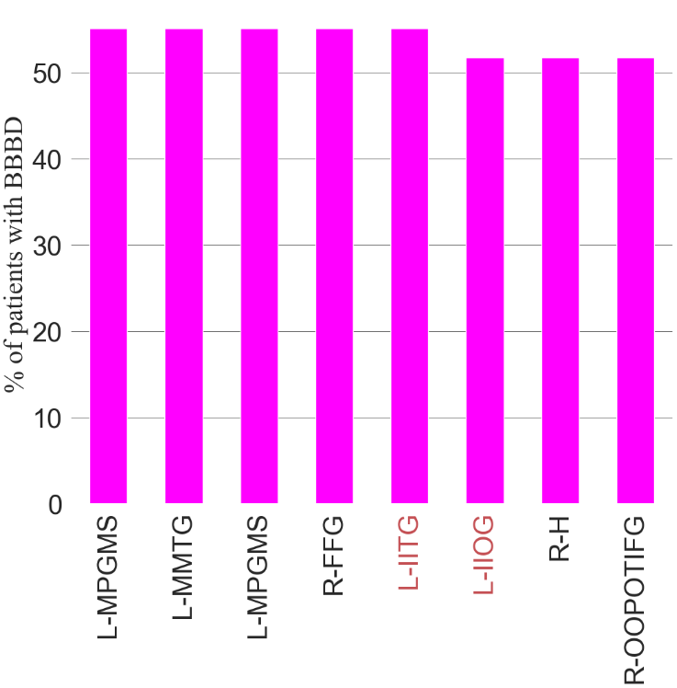
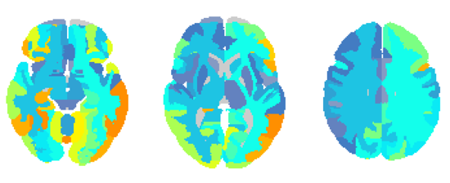
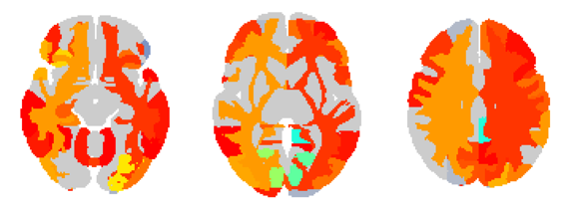
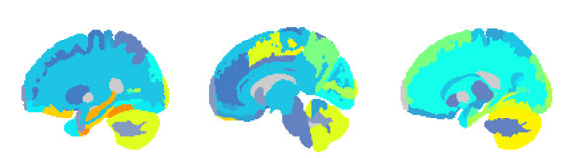
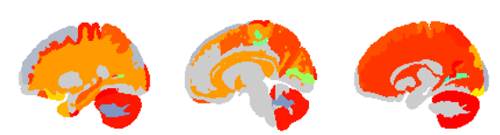
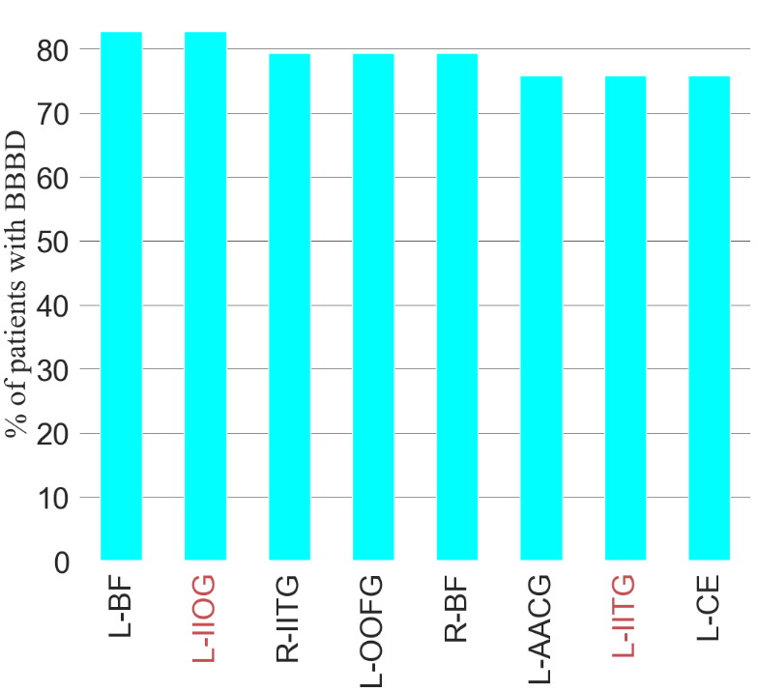
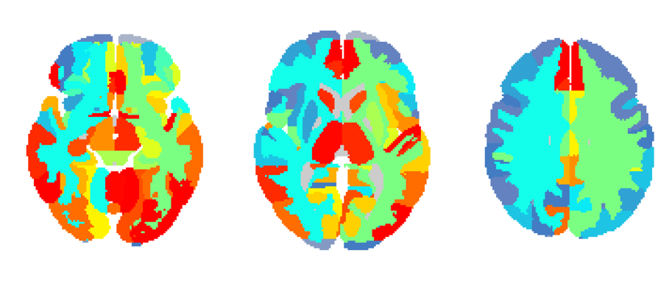
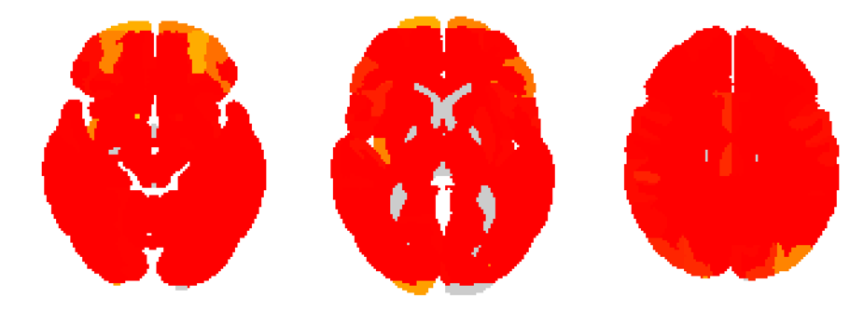
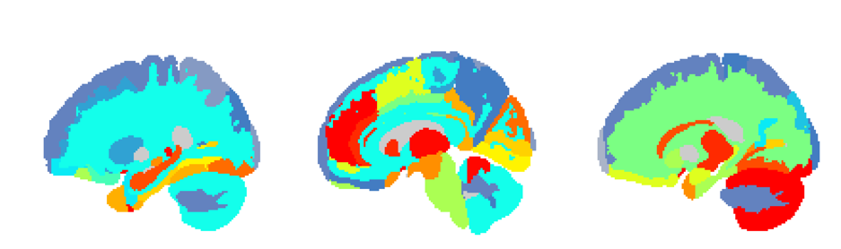
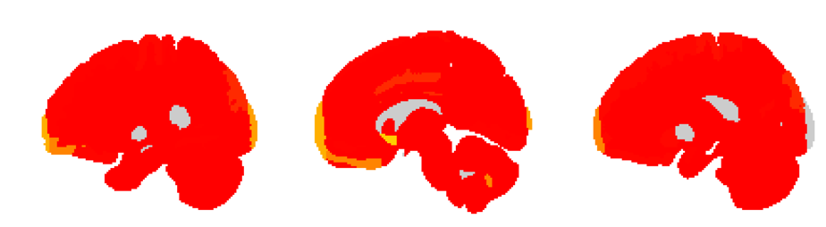
FIGURE 2: Regional analysis
A Fast
C Fast
E Fast
B Slow
Patients with BBBD, % all
D Slow
P-value
F Slow
Figure 2 . (A) Percent of epileptic patients with BBBD of each region in fast model. (B) Significant regions of epileptic patients compared to controls in fast model. (C) Percent of epileptic patients with BBBD of each region in slow model. . (D) Significant regions of epileptic patients compared to controls in slow model. (E) Regions with most % of patients with BBBD in fast model (p value < 0.0001). (F) Regions with most % of patients with BBBD in slow model (p value < 1e-06). Areas in red are highly significant in both models. Regions legend; L-AACG: Left ACgG anterior cingulate gyrus, L-BF: Left Basal Forebrain, L-CE: Left Cerebellum Exterior, L-IIOG: Left IOG inferior occipital gyrus, L-IITG: Left ITG inferior temporal gyrus, L-MPGMS: Left MPrG precentral gyrus medial segment, L-MMTG: Left MTG middle temporal gyrus, L-OOFG: Left OFuG occipital fusiform gyrus, R-BF: Right Basal Forebrain, R-FFG: Right FuG fusiform gyrus, R-H: Right Hippocampus, R-IITG: Right ITG inferior temporal gyrus, R-OOPOTIFG: Right OrIFG orbital part of the inferior frontal gyrus
Notes:
Examples:
EA 0804
LL 0265
BT 3007 – left side
Optional:
AF7084 – linear and tofts diffuse
BA 5372 – linear G and tofts F

Slide 3
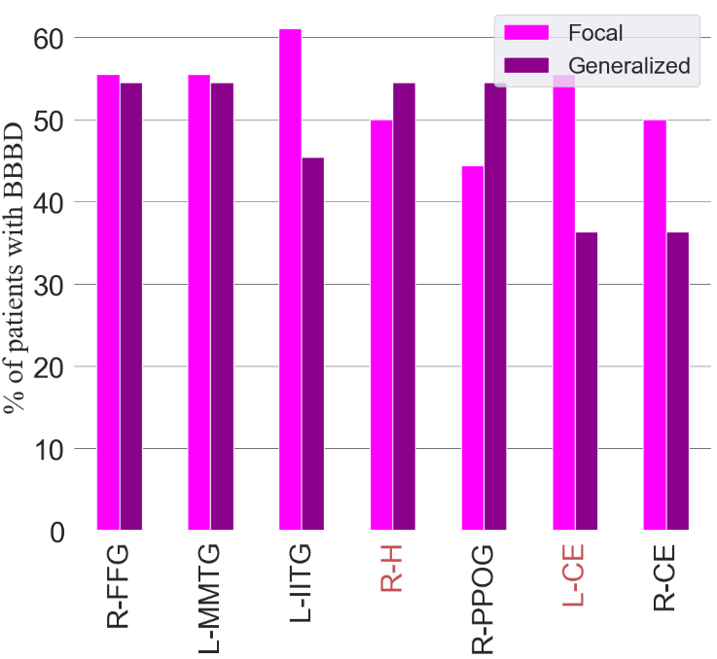
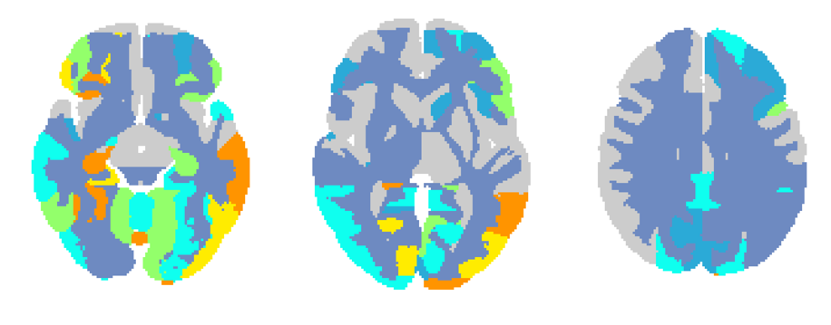
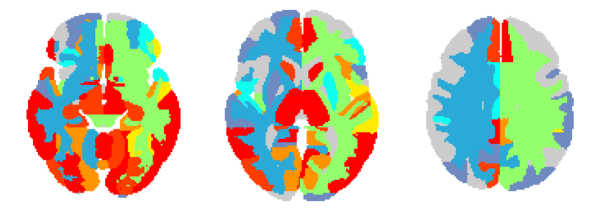
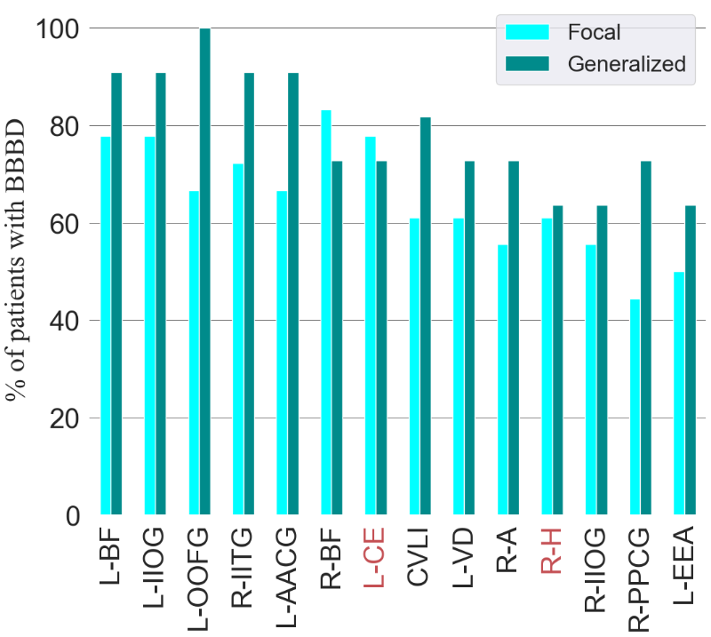
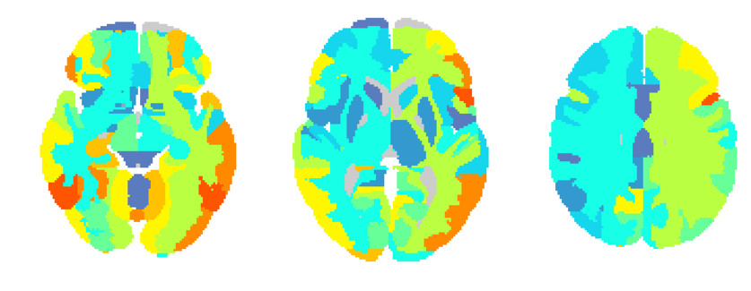
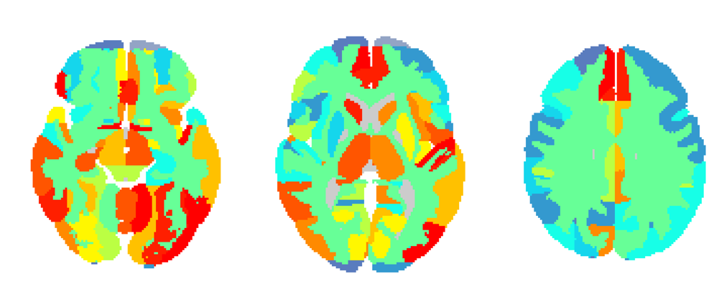
FIGURE 3: Focal vs Generalized
A Generalized
C
D Fast
Fast
Slow
B Focal
Patients with BBBD, % all
Focal - fast
E Slow
Fast
Slow
Figure 3 Similar BBBD behavior of slow and fast models. (A) Percent of focal epileptic patients with fast BBBD in each region. (B) Percent of generalized epileptic patients with fast BBBD in each region. (C) Statistics of focal and generalized epileptic patients. (D) Regions with most % of patients with BBBD in fast model (p value < .01). (E) Regions with most % of patients with BBBD in slow model (p value < .0005). Areas in red are highly significant in both models. Regions legend; CVLI: Cerebellar Vermal Lobules I-V, L-AACG: Left ACgG anterior cingulate gyrus, L-BF: Left Basal Forebrain, L-CE: Left Cerebellum Exterior, L-EEA: Left Ent entorhinal area, L-IIOG: Left IOG inferior occipital gyrus, L-IITG: Left ITG inferior temporal gyrus, L-MMTG: Left MTG middle temporal gyrus, L-OOFG: Left OFuG occipital fusiform gyrus, L-VD: Left Ventral DC, R-A: Right Amygdala, R-BF: Right Basal Forebrain, R-CE: Right Cerebellum Exterior, R-FFG: Right FuG fusiform gyrus, R-H: Right Hippocampus, R-IIOG: Right IOG inferior occipital gyrus, R-IITG: Right ITG inferior temporal gyrus, R-PPCG: Right PCgG posterior cingulate gyrus, R-PPOG: Right POrG posterior orbital gyrus
Notes:
G
AE 2898
DJ 5694
SH 1959
F
VA 6538
LL 0265
TA 4648

Slide 4
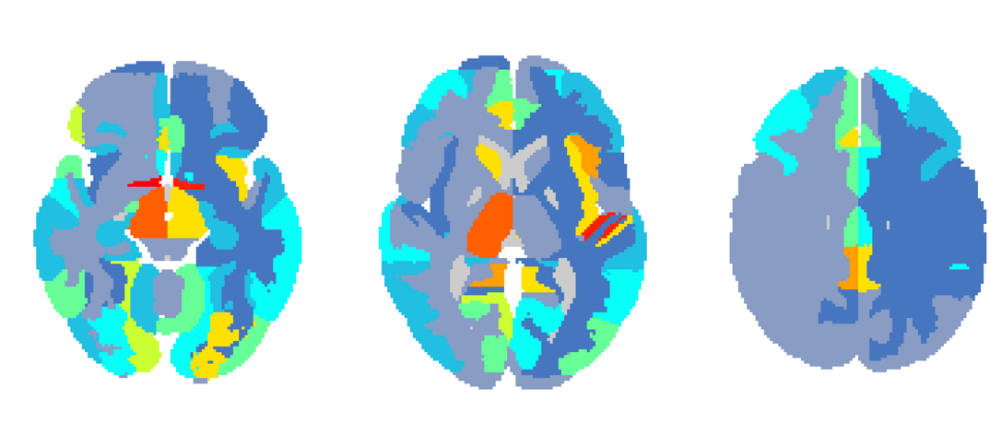
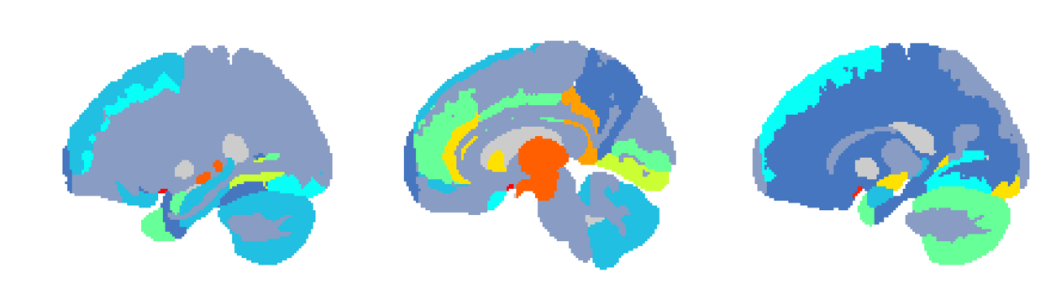
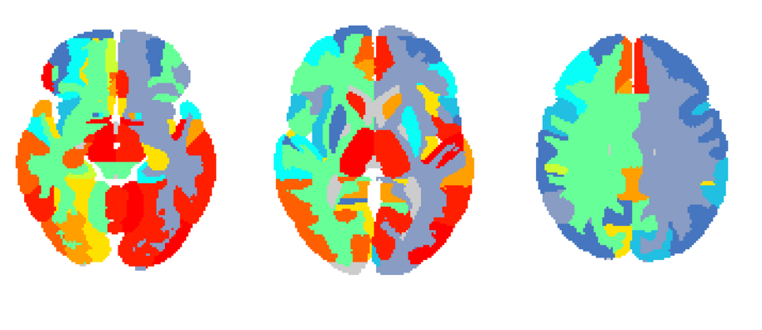
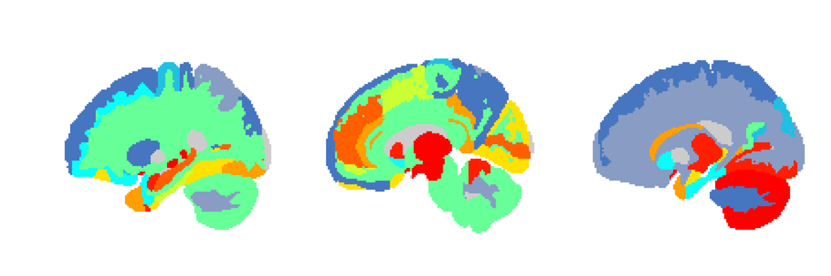
FIGURE 4: Frontal focal epilepsy
C Fast
A Fast
Patients with BBBD, % all
D Slow
B Slow
Figure 4 Focal regions are characterized with more BBBD. (A) Patients with temporal epilepsy compared to other epileptic patients in temporal regions in fast model. (B) Patients with temporal epilepsy compared to other epileptic patients in temporal regions in slow model. Temporal areas; 0: Left ITG inferior temporal gyrus, 1: Left MTG middle temporal gyrus, 2: Left PT planum temporale, 3: Left STG superior temporal gyrus, 4: Left TMP temporal pole, 5: Left TTG transverse temporal gyrus, 6: Right ITG inferior temporal gyrus, 7: Right MTG middle temporal gyrus, 8: Right PT planum temporale, 9: Right STG superior temporal gyrus, 10: Right TMP temporal pole, 11: Right TTG transverse temporal gyrus. (C) Patients with frontal epilepsy compared to other epileptic patients in frontal regions in fast model. (D) Patients with frontal epilepsy compared to other epileptic patients in frontal regions in slow model. Frontal areas; 0: Left FO frontal operculum, 1: Left FRP frontal pole, 2: Left MFC medial frontal cortex, 3: Left MFG middle frontal gyrus, 4: Left MSFG superior frontal gyrus medial segment, 5: Left OpIFG opercular part of the inferior frontal gyrus, 6: Left OrIFG orbital part of the inferior frontal gyrus, 7: Left SFG superior frontal gyrus, 8: Left TrIFG triangular part of the inferior frontal gyrus, 9: Right FO frontal operculum, 10: Right FRP frontal pole, 11: Right MFC medial frontal cortex, 12: Right MFG middle frontal gyrus, 13: Right MSFG superior frontal gyrus medial segment, 14: Right OpIFG opercular part of the inferior frontal gyrus, 15: Right OrIFG orbital part of the inferior frontal gyrus, 16: Right SFG superior frontal gyrus, 17: Right TrIFG triangular part of the inferior frontal gyrus.
N
Frontal epilepsy = 15
Rest epilepsy = 25
N
Temporal epilepsy = 13
Rest epilepsy = 27

Slide 5
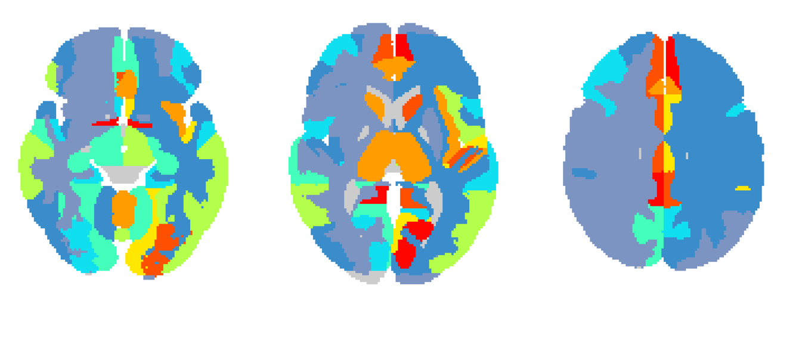
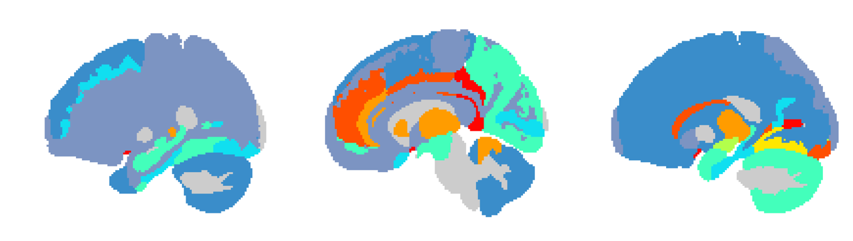
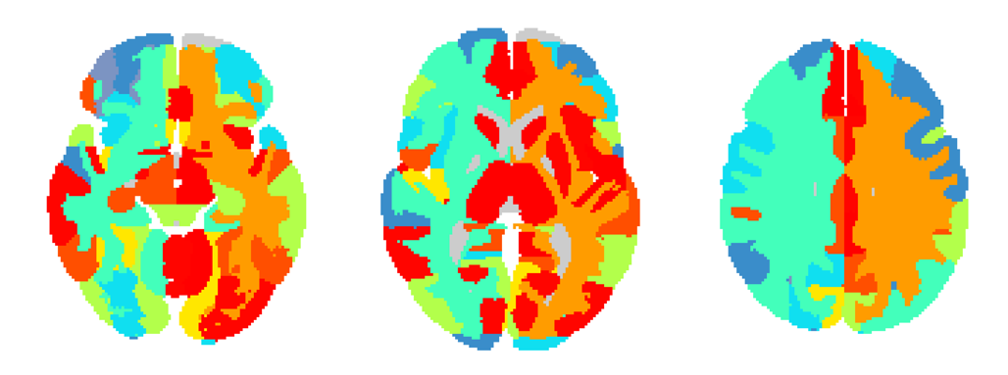
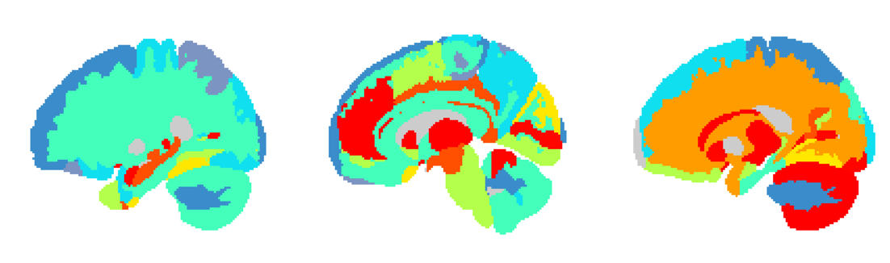
FIGURE 4: Temporal focal epilepsy
C Fast
A Fast
Patients with BBBD, % all
B Slow
D Slow
Figure 4 Focal regions are characterized with more BBBD. (A) Patients with temporal epilepsy compared to other epileptic patients in temporal regions in fast model. (B) Patients with temporal epilepsy compared to other epileptic patients in temporal regions in slow model. Temporal areas; 0: Left ITG inferior temporal gyrus, 1: Left MTG middle temporal gyrus, 2: Left PT planum temporale, 3: Left STG superior temporal gyrus, 4: Left TMP temporal pole, 5: Left TTG transverse temporal gyrus, 6: Right ITG inferior temporal gyrus, 7: Right MTG middle temporal gyrus, 8: Right PT planum temporale, 9: Right STG superior temporal gyrus, 10: Right TMP temporal pole, 11: Right TTG transverse temporal gyrus. (C) Patients with frontal epilepsy compared to other epileptic patients in frontal regions in fast model. (D) Patients with frontal epilepsy compared to other epileptic patients in frontal regions in slow model. Frontal areas; 0: Left FO frontal operculum, 1: Left FRP frontal pole, 2: Left MFC medial frontal cortex, 3: Left MFG middle frontal gyrus, 4: Left MSFG superior frontal gyrus medial segment, 5: Left OpIFG opercular part of the inferior frontal gyrus, 6: Left OrIFG orbital part of the inferior frontal gyrus, 7: Left SFG superior frontal gyrus, 8: Left TrIFG triangular part of the inferior frontal gyrus, 9: Right FO frontal operculum, 10: Right FRP frontal pole, 11: Right MFC medial frontal cortex, 12: Right MFG middle frontal gyrus, 13: Right MSFG superior frontal gyrus medial segment, 14: Right OpIFG opercular part of the inferior frontal gyrus, 15: Right OrIFG orbital part of the inferior frontal gyrus, 16: Right SFG superior frontal gyrus, 17: Right TrIFG triangular part of the inferior frontal gyrus.
N
Frontal epilepsy = 15
Rest epilepsy = 25
N
Temporal epilepsy = 13
Rest epilepsy = 27

Slide 6
FIGURE 4: Frontal and temporal focal epilepsy
A Fast
C Fast
B Slow
D Slow
Figure 4 Focal regions are characterized with more BBBD. (A) Patients with temporal epilepsy compared to other epileptic patients in temporal regions in fast model. (B) Patients with temporal epilepsy compared to other epileptic patients in temporal regions in slow model. Temporal areas; 0: Left ITG inferior temporal gyrus, 1: Left MTG middle temporal gyrus, 2: Left PT planum temporale, 3: Left STG superior temporal gyrus, 4: Left TMP temporal pole, 5: Left TTG transverse temporal gyrus, 6: Right ITG inferior temporal gyrus, 7: Right MTG middle temporal gyrus, 8: Right PT planum temporale, 9: Right STG superior temporal gyrus, 10: Right TMP temporal pole, 11: Right TTG transverse temporal gyrus. (C) Patients with frontal epilepsy compared to other epileptic patients in frontal regions in fast model. (D) Patients with frontal epilepsy compared to other epileptic patients in frontal regions in slow model. Frontal areas; 0: Left FO frontal operculum, 1: Left FRP frontal pole, 2: Left MFC medial frontal cortex, 3: Left MFG middle frontal gyrus, 4: Left MSFG superior frontal gyrus medial segment, 5: Left OpIFG opercular part of the inferior frontal gyrus, 6: Left OrIFG orbital part of the inferior frontal gyrus, 7: Left SFG superior frontal gyrus, 8: Left TrIFG triangular part of the inferior frontal gyrus, 9: Right FO frontal operculum, 10: Right FRP frontal pole, 11: Right MFC medial frontal cortex, 12: Right MFG middle frontal gyrus, 13: Right MSFG superior frontal gyrus medial segment, 14: Right OpIFG opercular part of the inferior frontal gyrus, 15: Right OrIFG orbital part of the inferior frontal gyrus, 16: Right SFG superior frontal gyrus, 17: Right TrIFG triangular part of the inferior frontal gyrus.
N
Frontal epilepsy = 11
Rest epilepsy = 18
N
Temporal epilepsy = 9
Rest epilepsy = 20

Slide 7
Frontal Vs Rest

Slide 8
Frontal Vs Rest

Slide 9
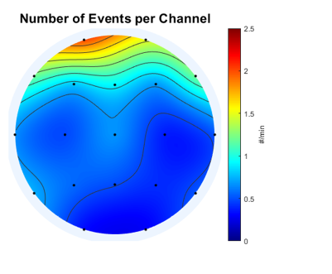
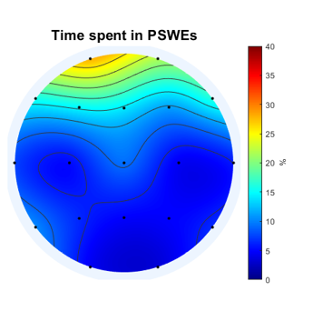
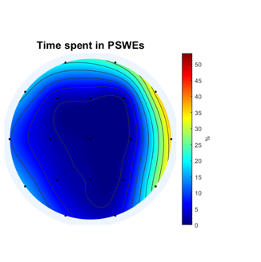
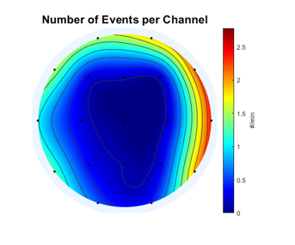
FIGURE 5: PSWE and BBBD
ME 4933
TA 4648

Slide 10
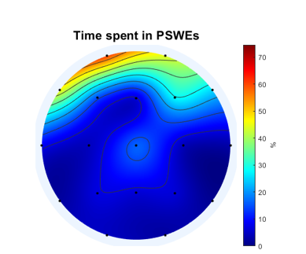
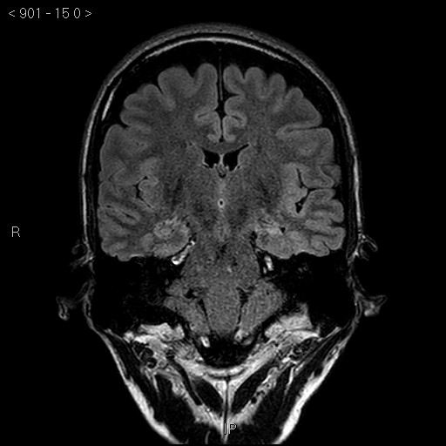
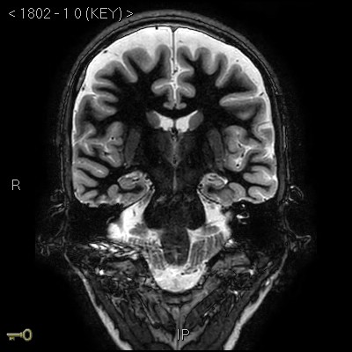
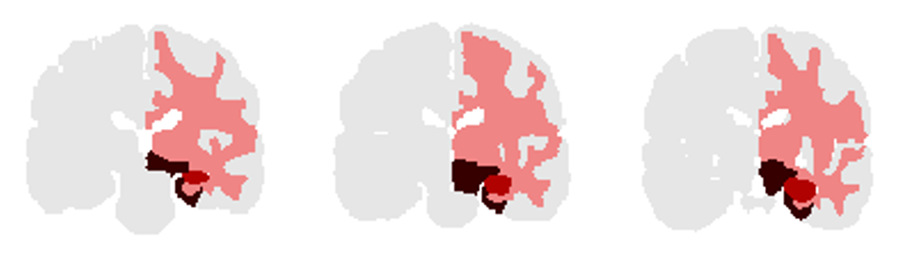
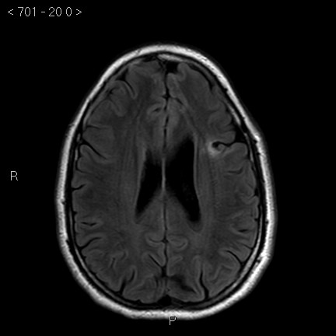
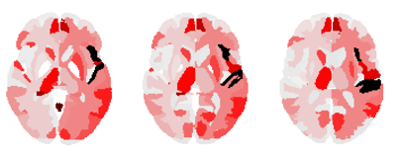
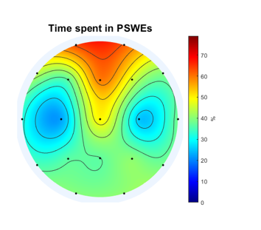
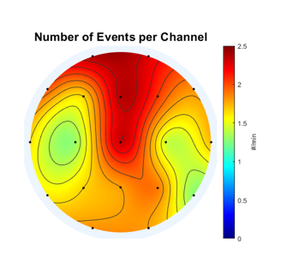
FIGURE 6: Lesion and BBBD
MH_4108
BT_3007

Slide 11
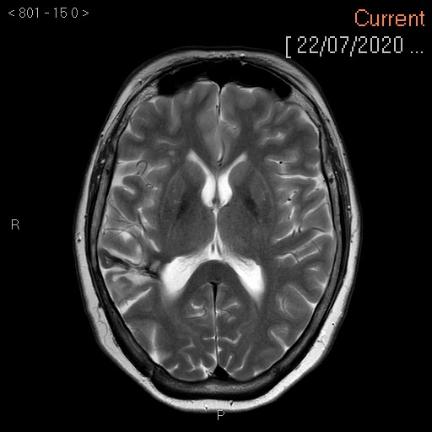
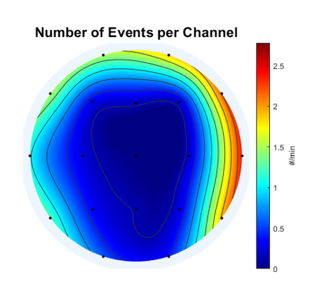




TA_4648
EA_0804

Slide 12



HY9719 Slow Fast

Slide 13
FIGURE 4: Temporal vs Frontal
D
A
B
C
D
N
Temporal epilepsy = 8
Rest epilepsy = 26
N
Frontal epilepsy = 10
Rest epilepsy = 24
Notes:
Theories:
* Generalized is a type of focal

Slide 14
FIGURE 4: Temporal vs Frontal
D
A
B
C
D
N
Temporal areas = 10
Other areas = 126
Notes:
Theories:
* Generalized is a type of focal

Slide 15
N
Patients with lesions– 13
Notes:
Theories:
* Generalized is a type of focal

Slide 16



A CONTROLS
C STATISTICS
0 slow 0.1
Fast
0 fast 0.1
Slow
D METHOD
B EPILEPSY
PWE 1 2 3 4
Fast
STD above controls
Slow
Figure 1 DCE-MRI reveals persistent BBBD in epileptic patients. (A) Examples of controls without BBBD, with fast BBBD and slow BBBD. (D) Examples of patients with epilepsy without BBBD, with fast BBBD and slow BBBD and both fast and slow BBBD. (C) Epileptic patients' statistics compared to controls. (D) BBBD analysis method
Notes:
CONTORLS:
PN_8563
HS_5404
CM_8261
Epilepsy
IE_2899
BT_3007
MB_1437

